Slide 1

EFFECTS OF FIREWORKS ON THE AIR QUALITY IN BUDAPEST
Felipe Reis Fernandes
MSc Diploma Thesis Defence
Supervisor: Dr. Salma Imre
ELTE Eötvös Loránd University, Budapest
Institute of Chemistry
Faculty of Science

Slide 2
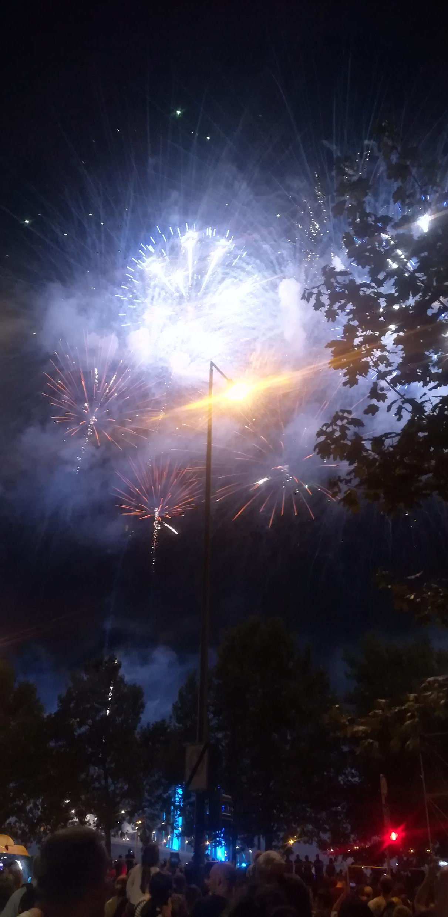
Introduction
Firework History: From China 10th Century to Europe 17th Century
Popular in many events:
China: New Year
India: Diwali
USA: Independence Day
Hungary: Saint Stephen’s Day
Saint Stephen’s Day: 20th August, Budapest
30 min usually
City Center along Danube
2021 – One of the largest events in Europe
Notes:
On events mention only saint Stephen’s day

Slide 3
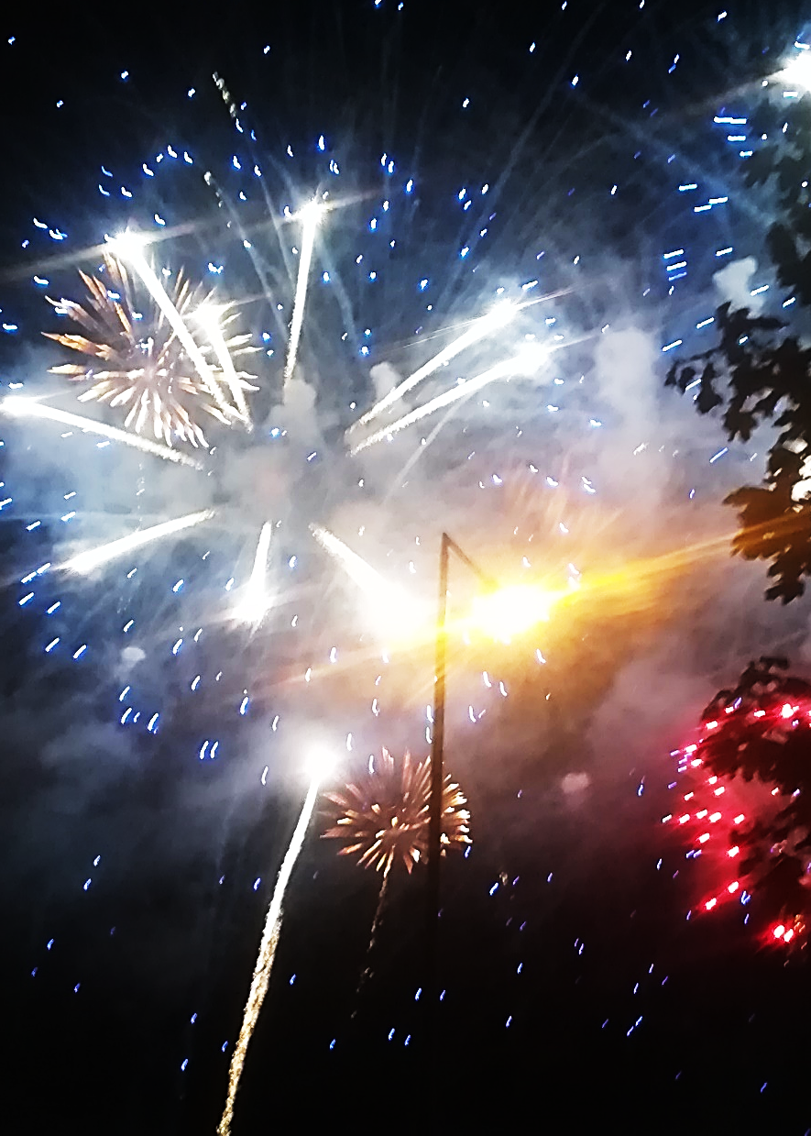
Fireworks
Composition:
Metals: Color (Sr, Ba, Cu), Fuel (Mg, Al, Zn)
Fuel: C (black carbon, sugar), S, P
Oxidants: (per)chlorates, nitrates
Pollution:
O₃, SO₂, NO_{x}, CO , Aerosols
Particles containing metals, toxic organic compounds
WHO (UF): 1 h mean > 20k cm⁻³ – High
Goals:
Characterize air pollution of the event
Particle number concentration and size distribution
Possible influence of meteorological conditions
Notes:
On Composition no need to discriminated each element, rather only the 3 main groups
On pollution focus on the aerosol/particles, no need to mention the others

Slide 4
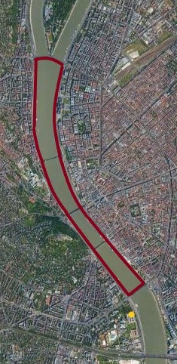
Methods
Years: 2009, 2014, 2015, 2016,2017, 2020 and 2021
From 20:00 to 23:30
Before Time (BT): 20:00 to 21:00
During Time (DT): 21:00 to 22:00
After Time (AT): 22:30 to 23:30
Location: BpART Lab (yellow dot)
Measurements:
Differential Mobility Particle Sizer (DMPS) – Concentration and size distribution
Condensation Particle Counter (CPC) – Total concentration
WS, WD, T and RH – Meteorological Parameters
Data treatment:
Descriptive statistics
Welch’s t-test for mean comparison (two side: α= 0.1, one side: α=0.0.5)
RDiff: Relative Difference of Means
Z-value: Relative mean difference to standard deviation

Slide 5
Results and Discussion
2021 as base:
Size ranges
Time intervals
Initial pattern recognition with contour plots
Descriptive statistics
Central tendencies and distribution
Particle size distribution and proportions
Event and non-event comparisons

Slide 6
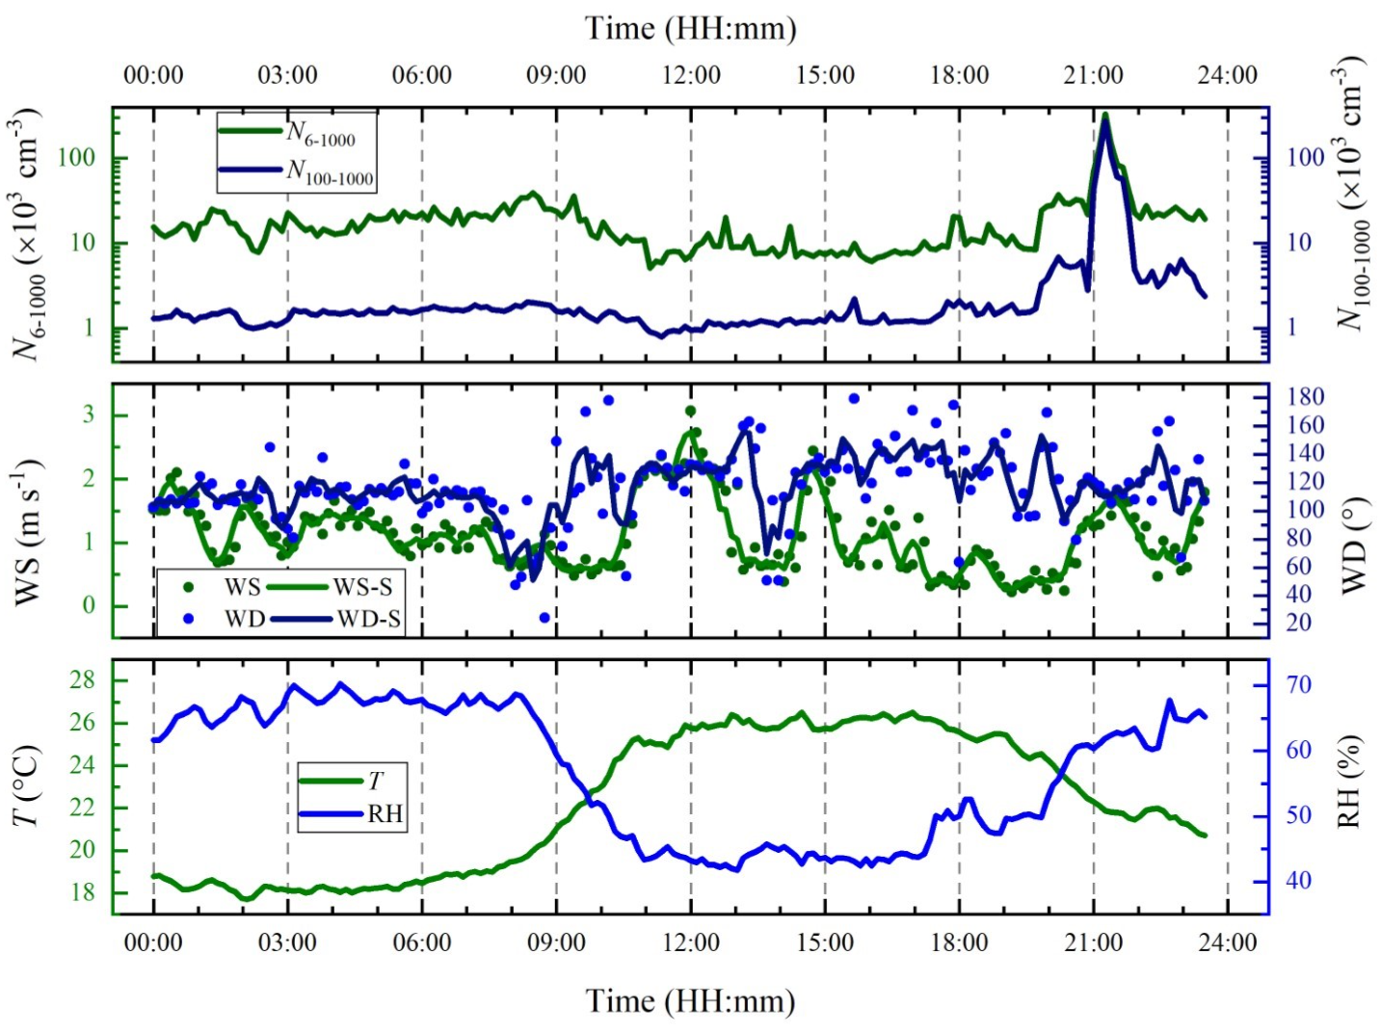
2021 Day Parameters

Slide 7
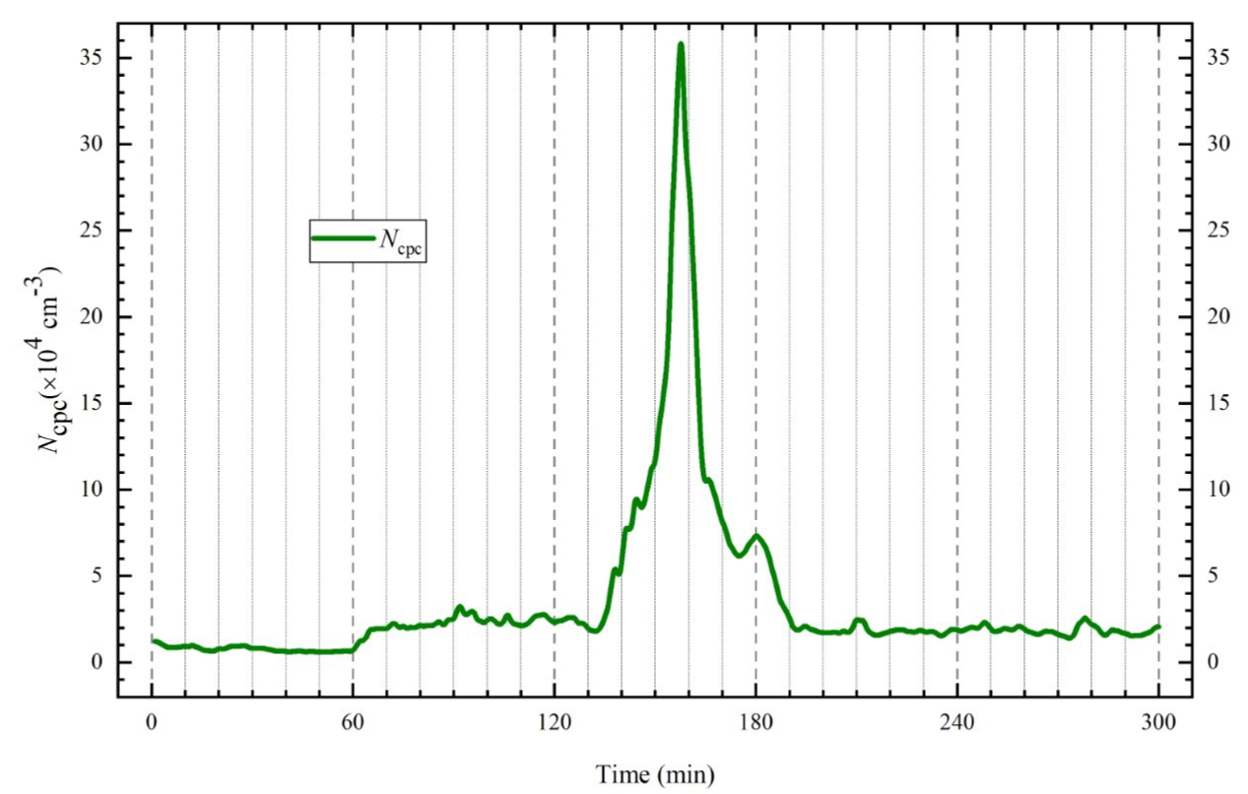
CPC (N₆₋₁₀₀₀)

Slide 8
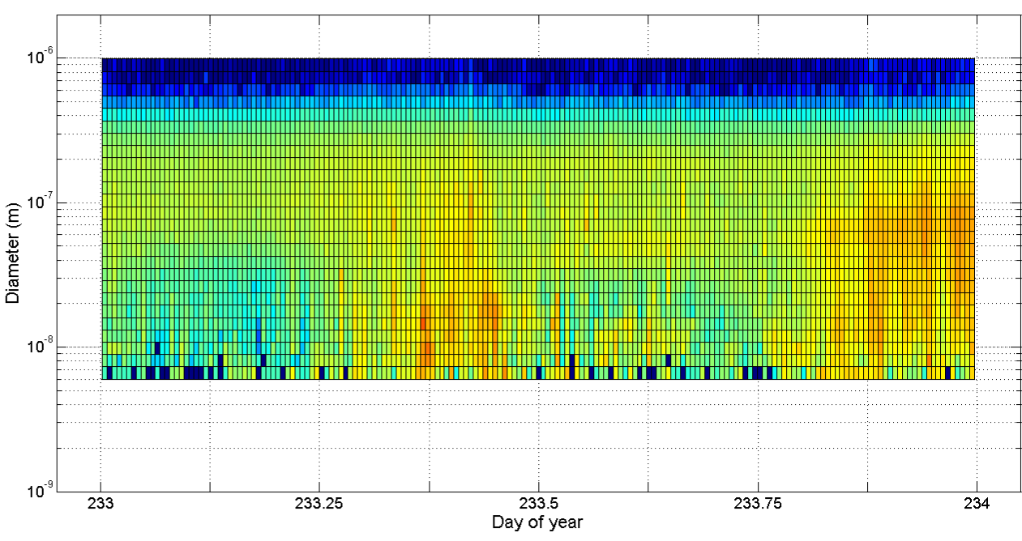
2020

Slide 9
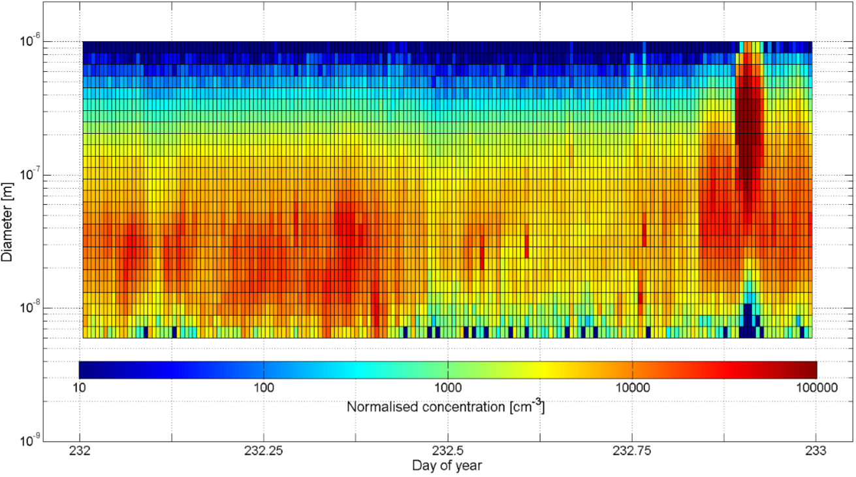
2021

Slide 10
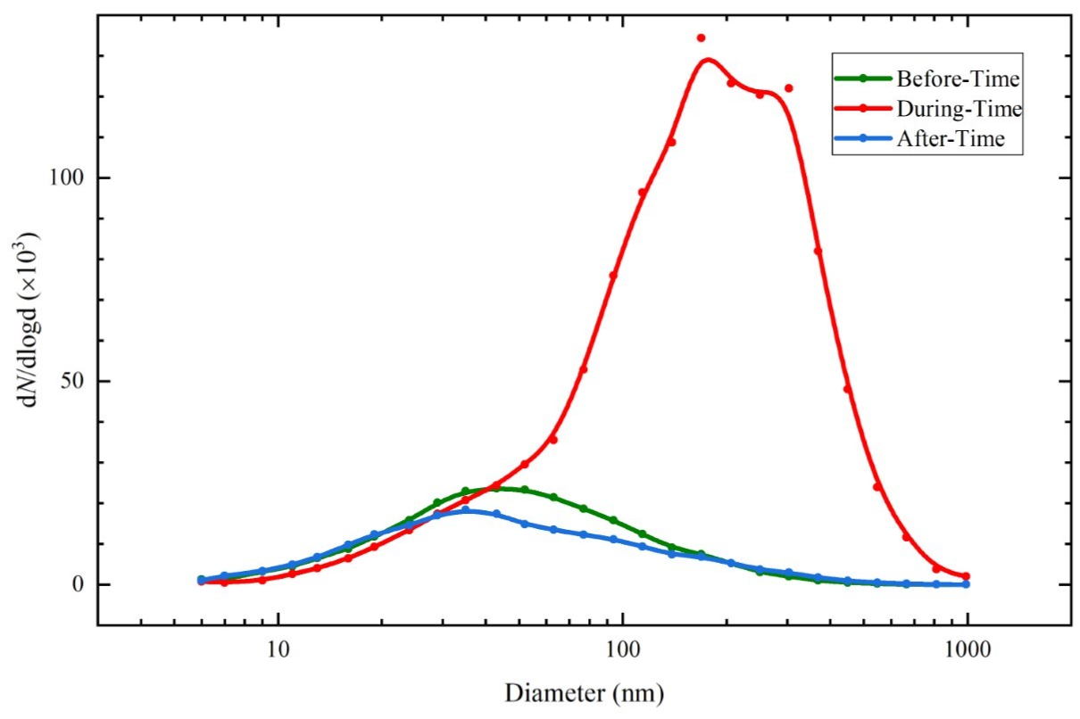
Particle Size Distribution (2021)

Slide 11
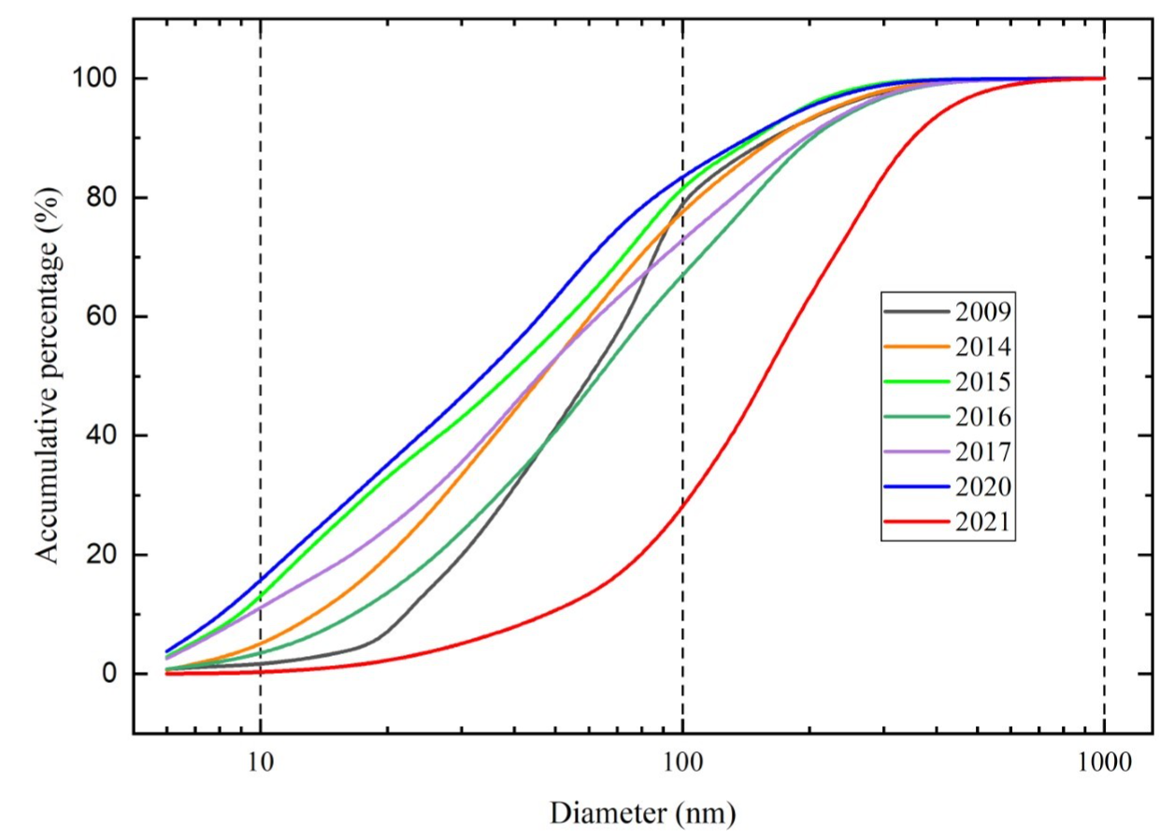
Relative Particle Size Distribution

Slide 12
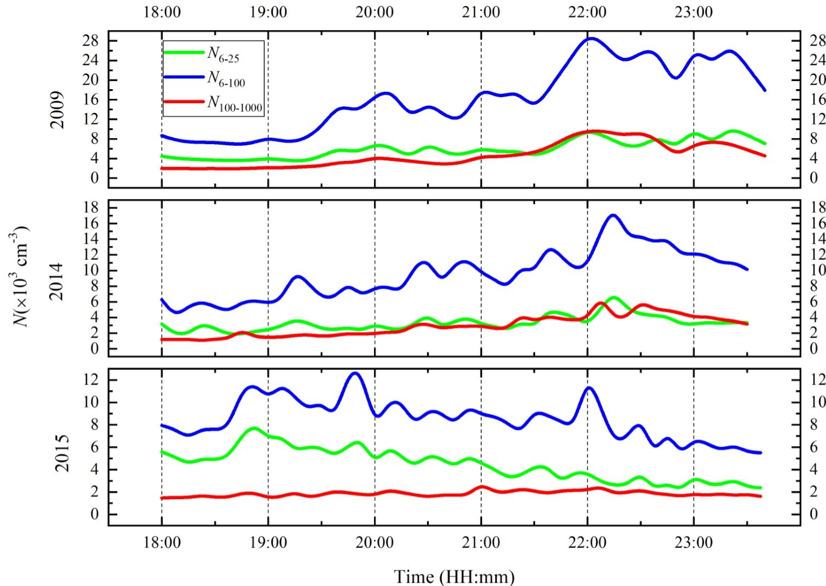
Particle Size Change (2009, 2014, 2015)

Slide 13
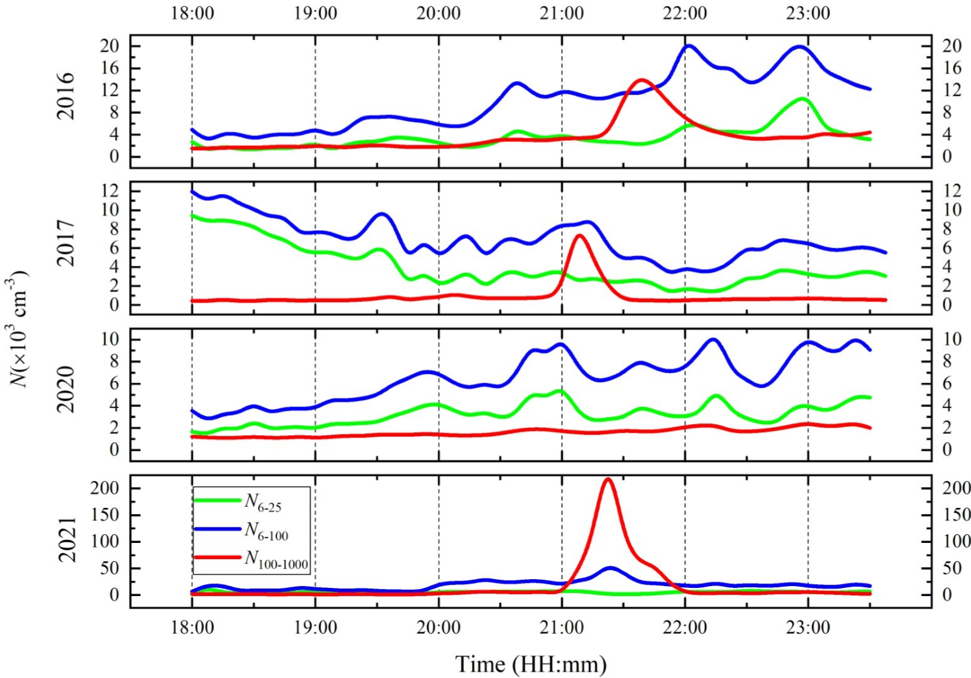
Particle Size Change (2016,2017,2020,2021)

Slide 14
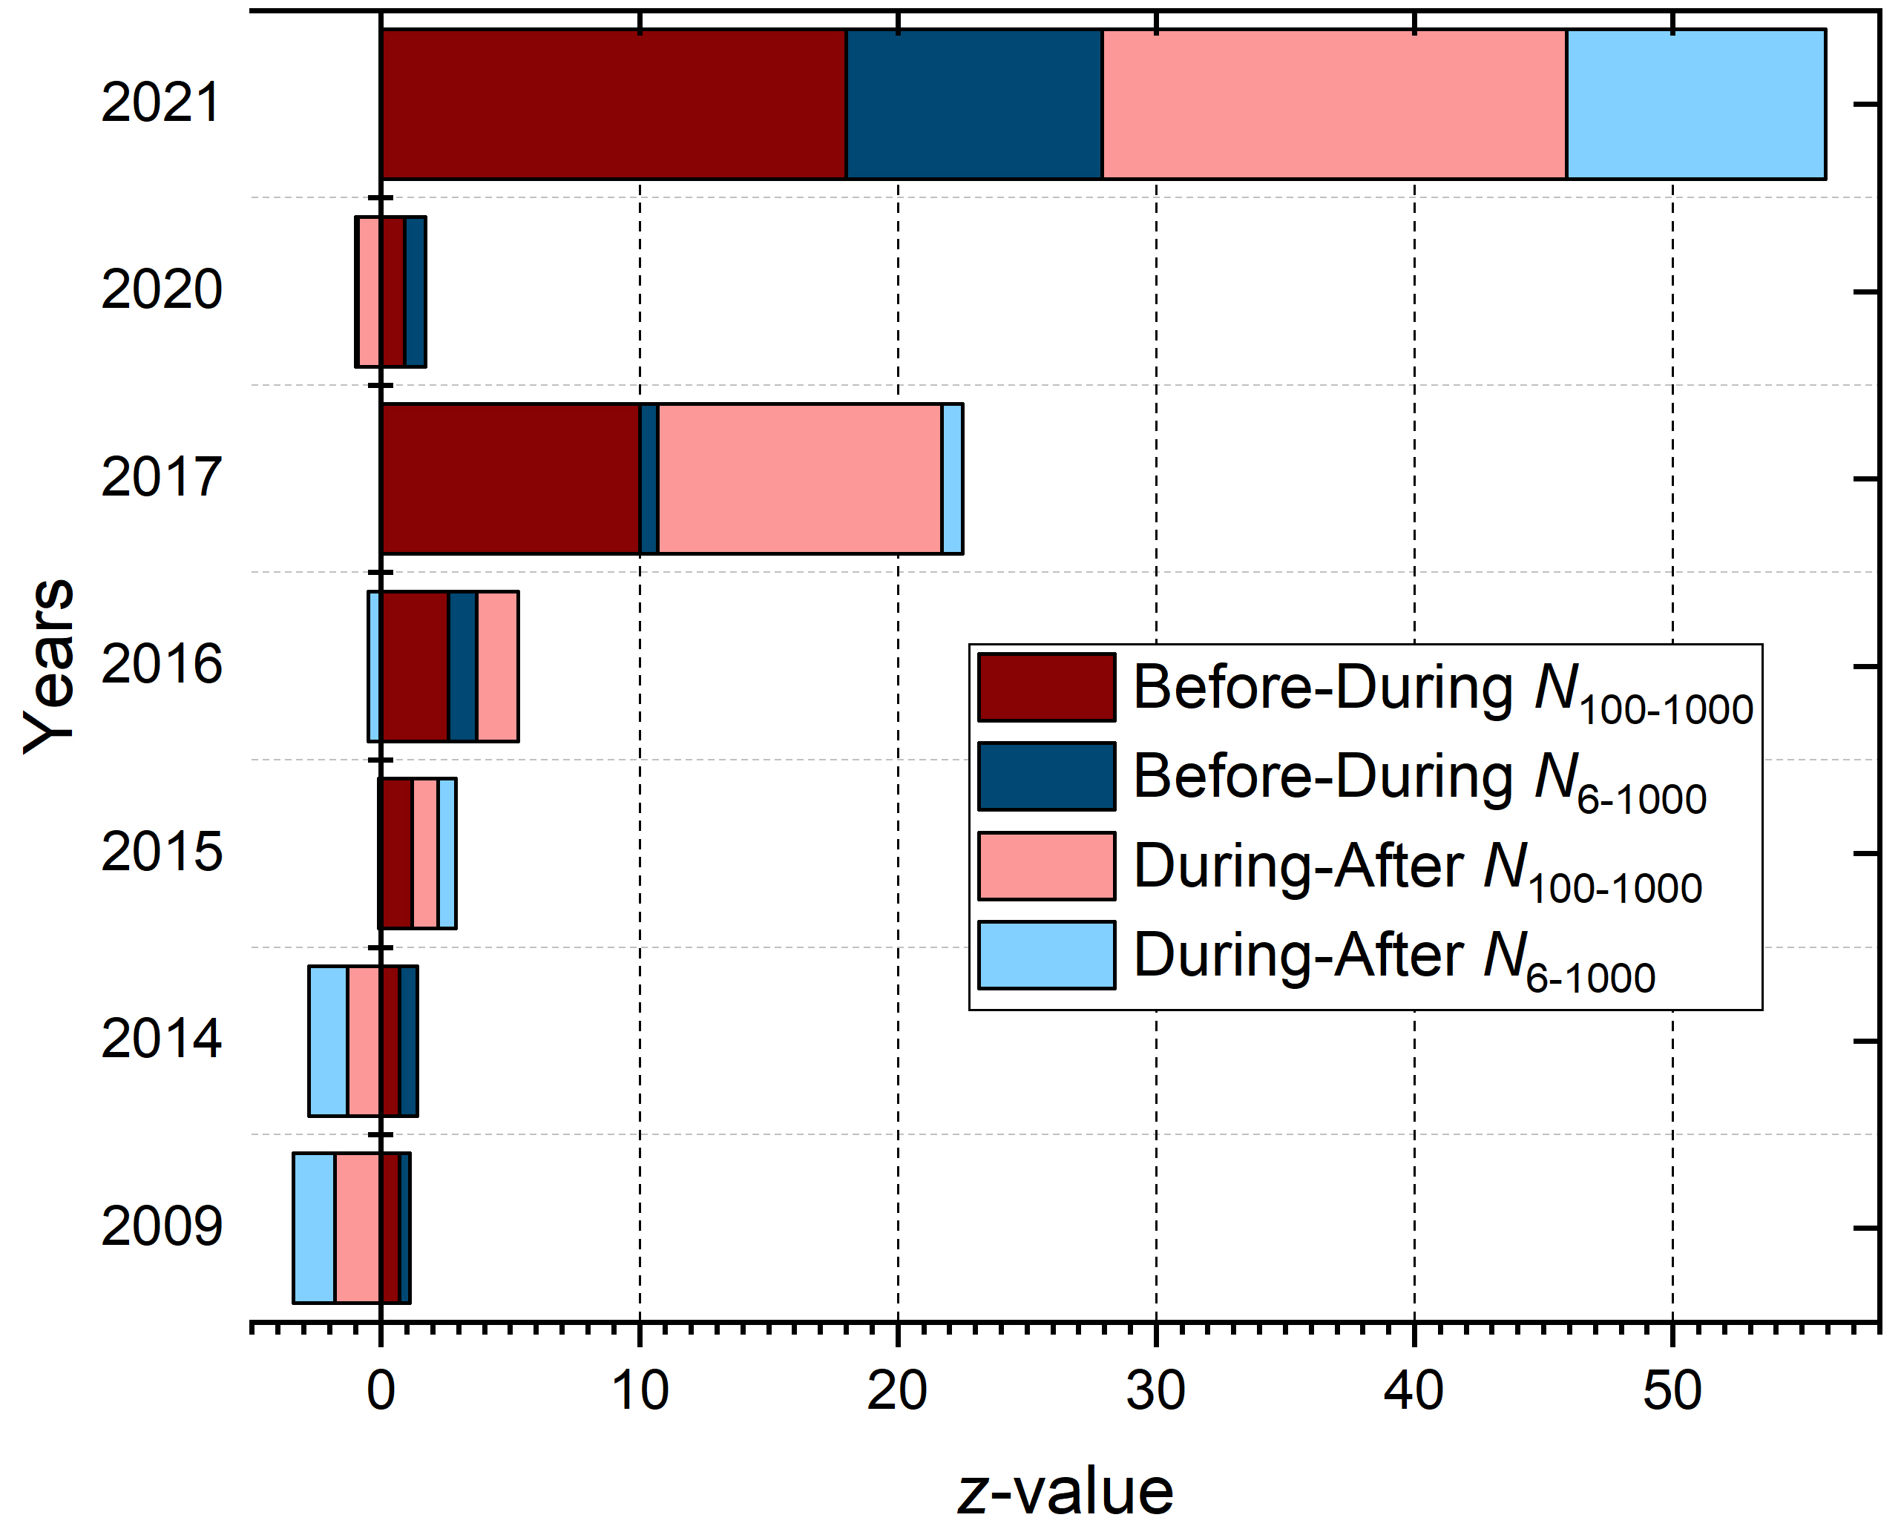
z-value

Slide 15
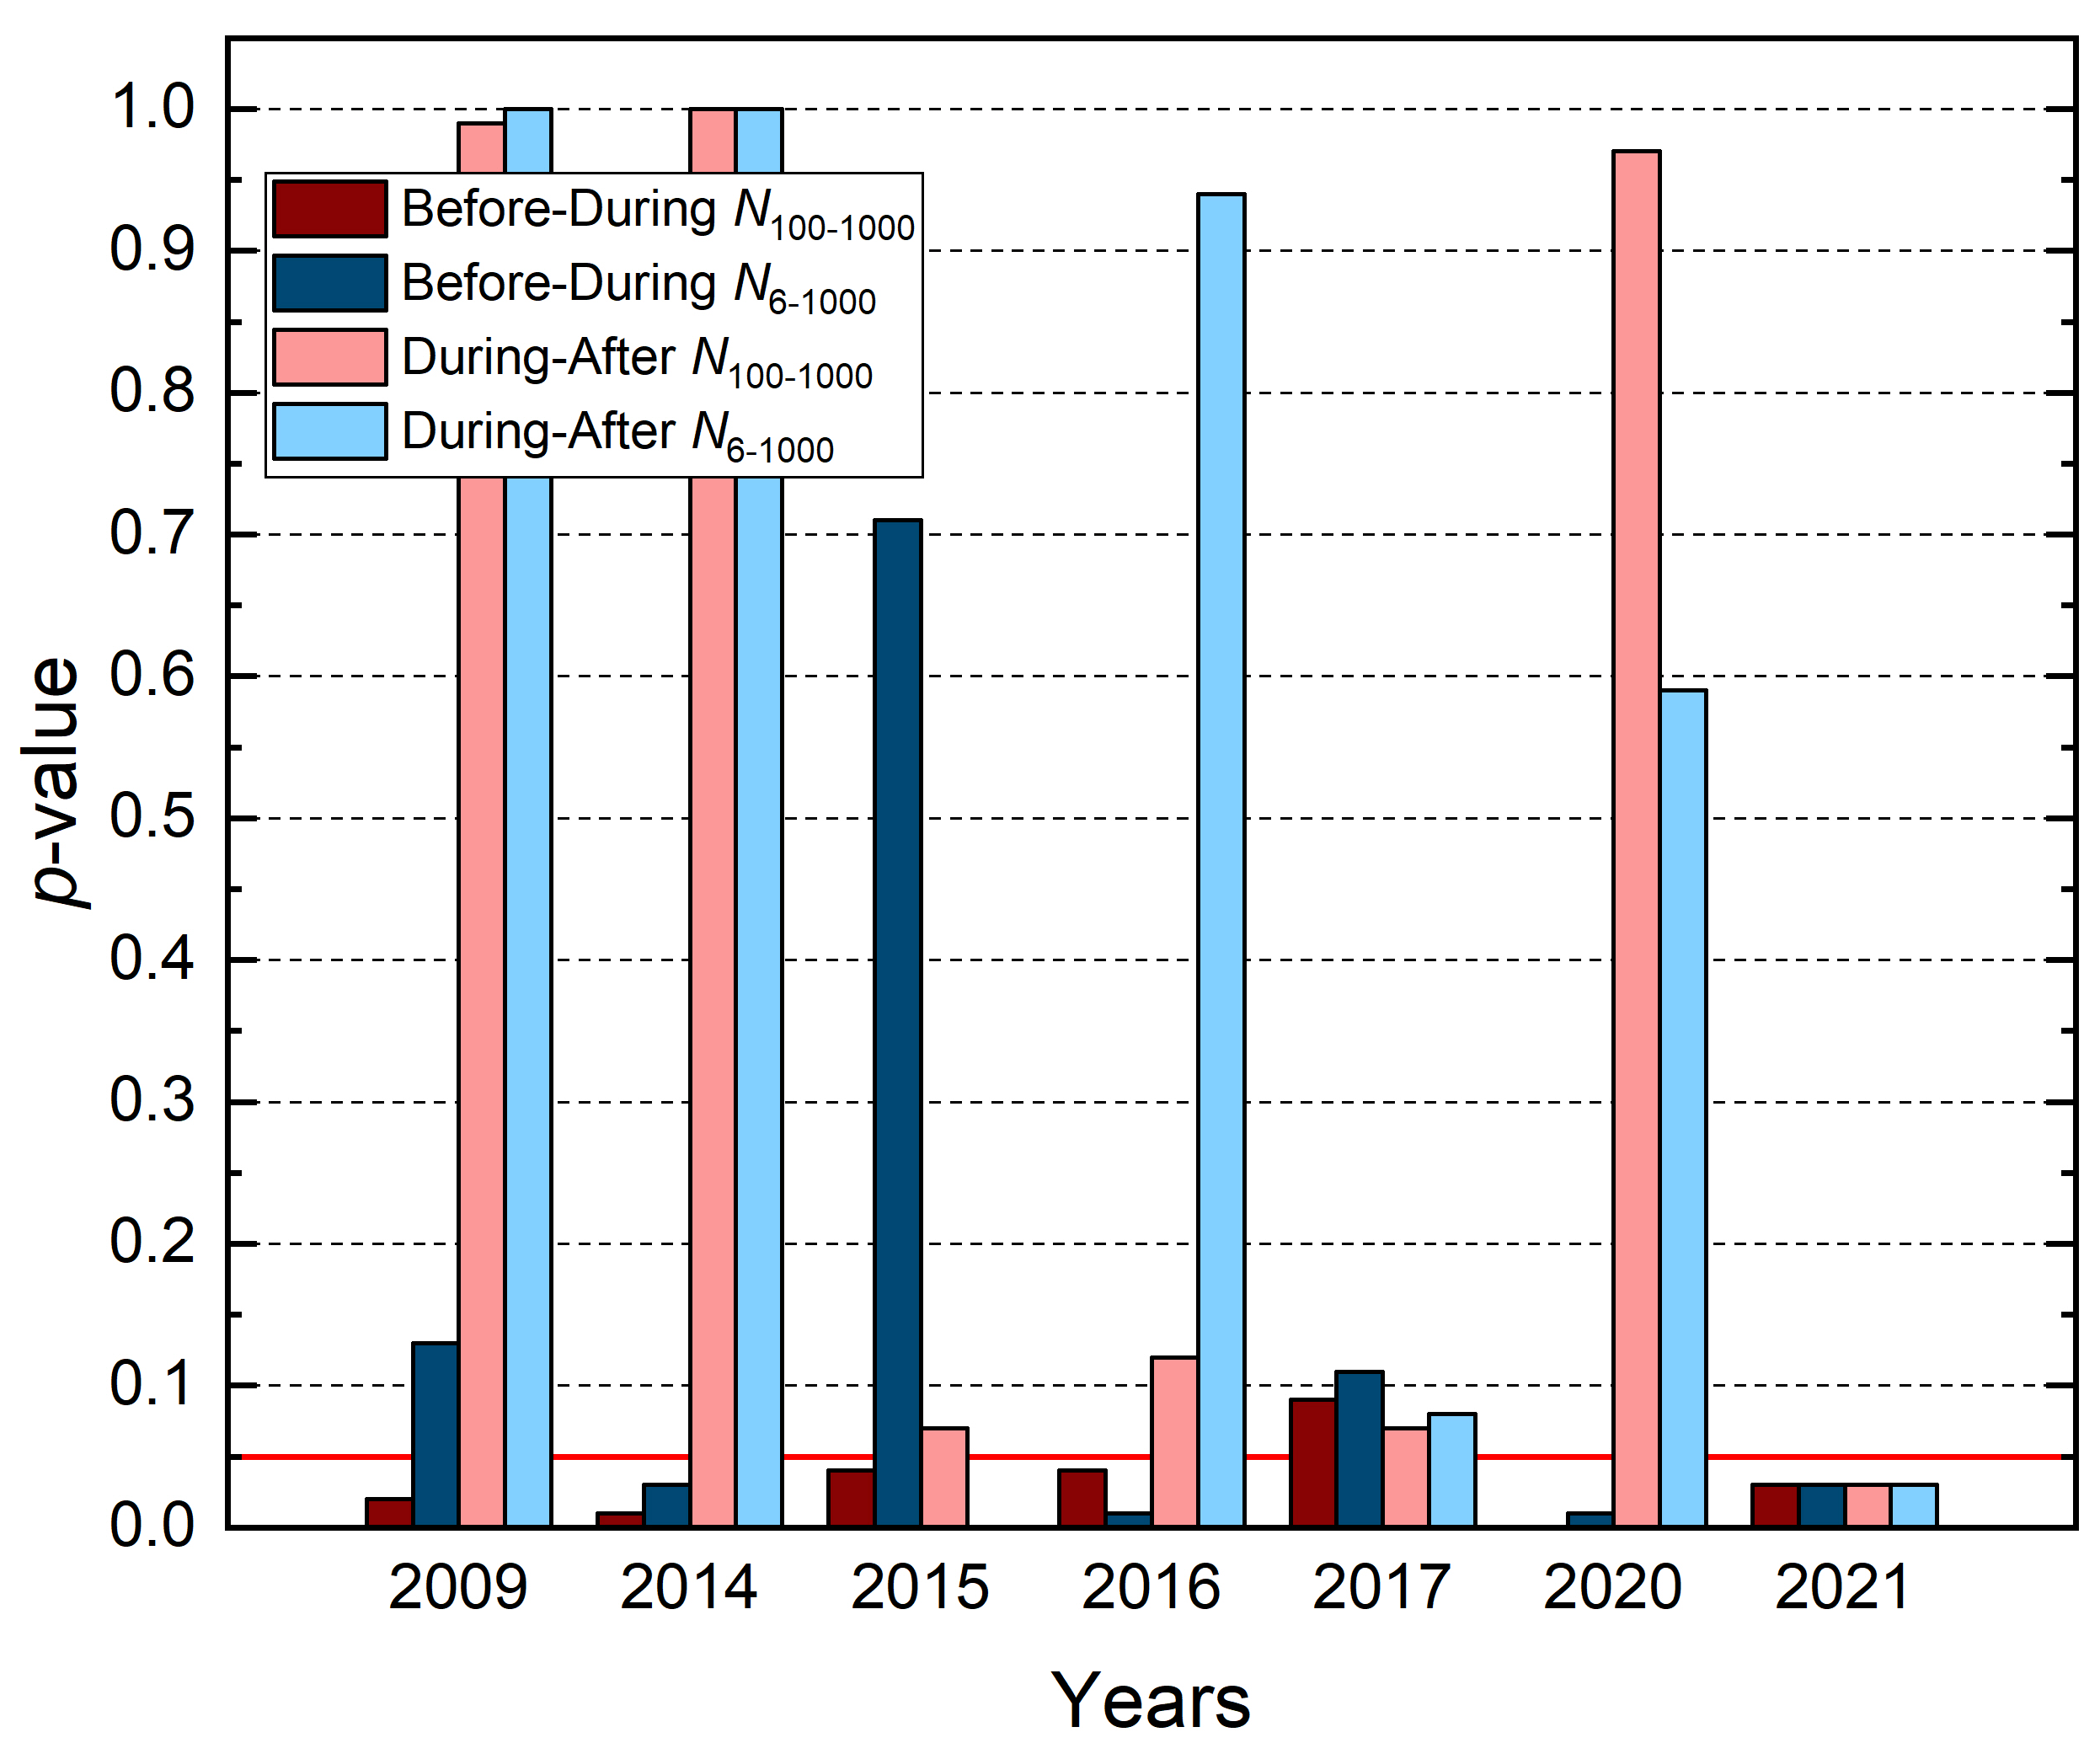
Welch’s t-test one sided

Slide 16
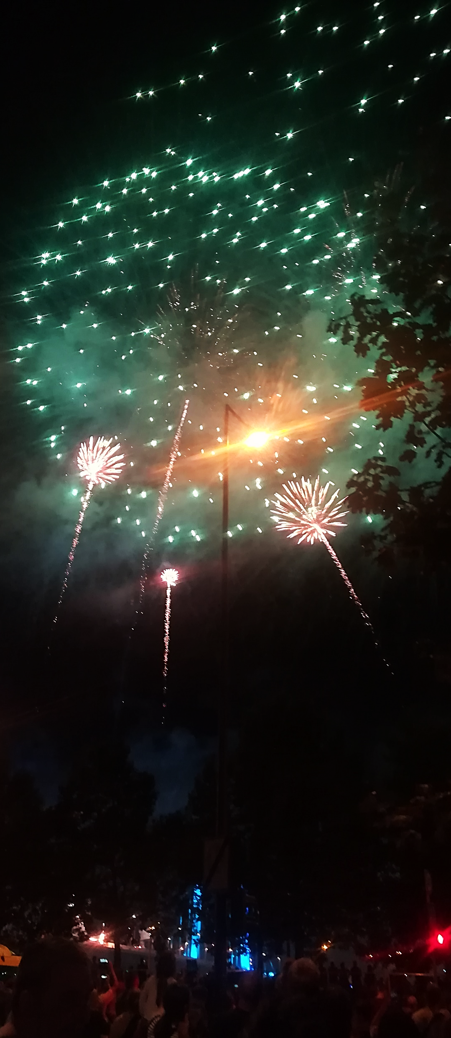
Conclusion
Most of the particles produced are within 40 and 400 nm
Weather conditions can change the detectability of the event
Using other tools such as scattered sensors, drones, checking for trace metals could improve the data collected
Fireworks generate a beautiful spectacle that do not last for long time
Very intensive events can generate pollution levels harmful for Human health
Intercalating or substituting fireworks with lights and drones can bring the pollution to safety levels

Slide 17
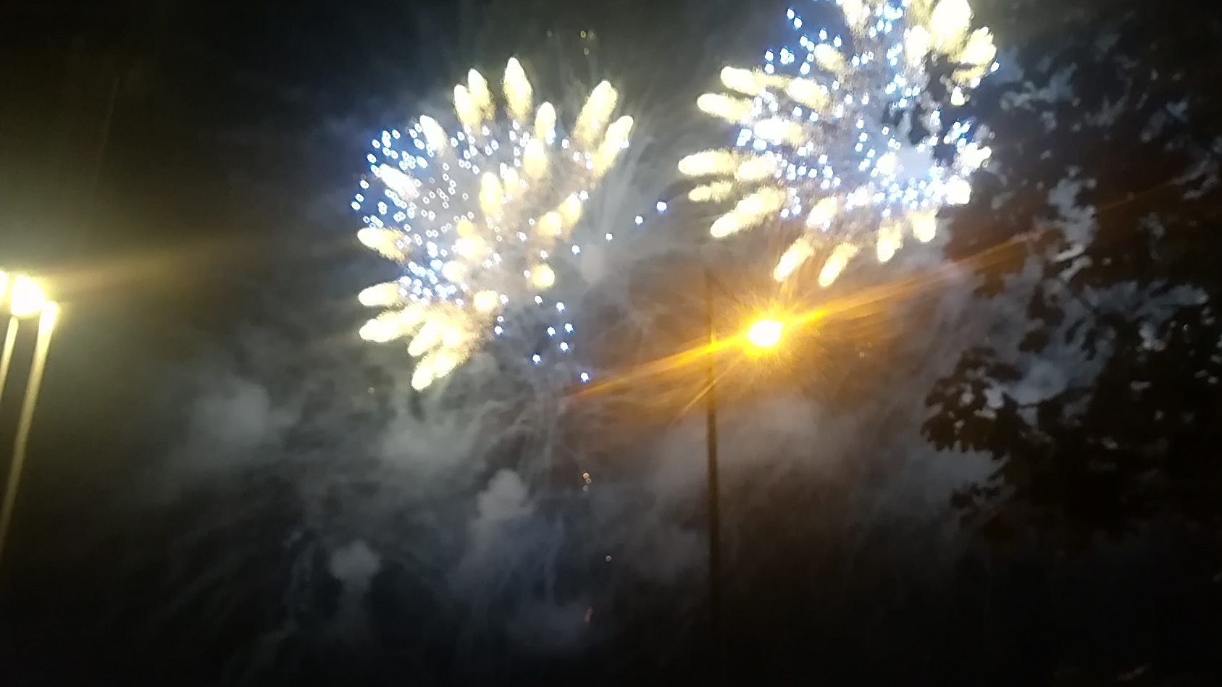
Thank you

Slide 18
Additional Material

Slide 19
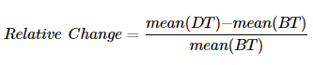
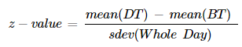
Mean Comparison
RDiff
z-value

Slide 20
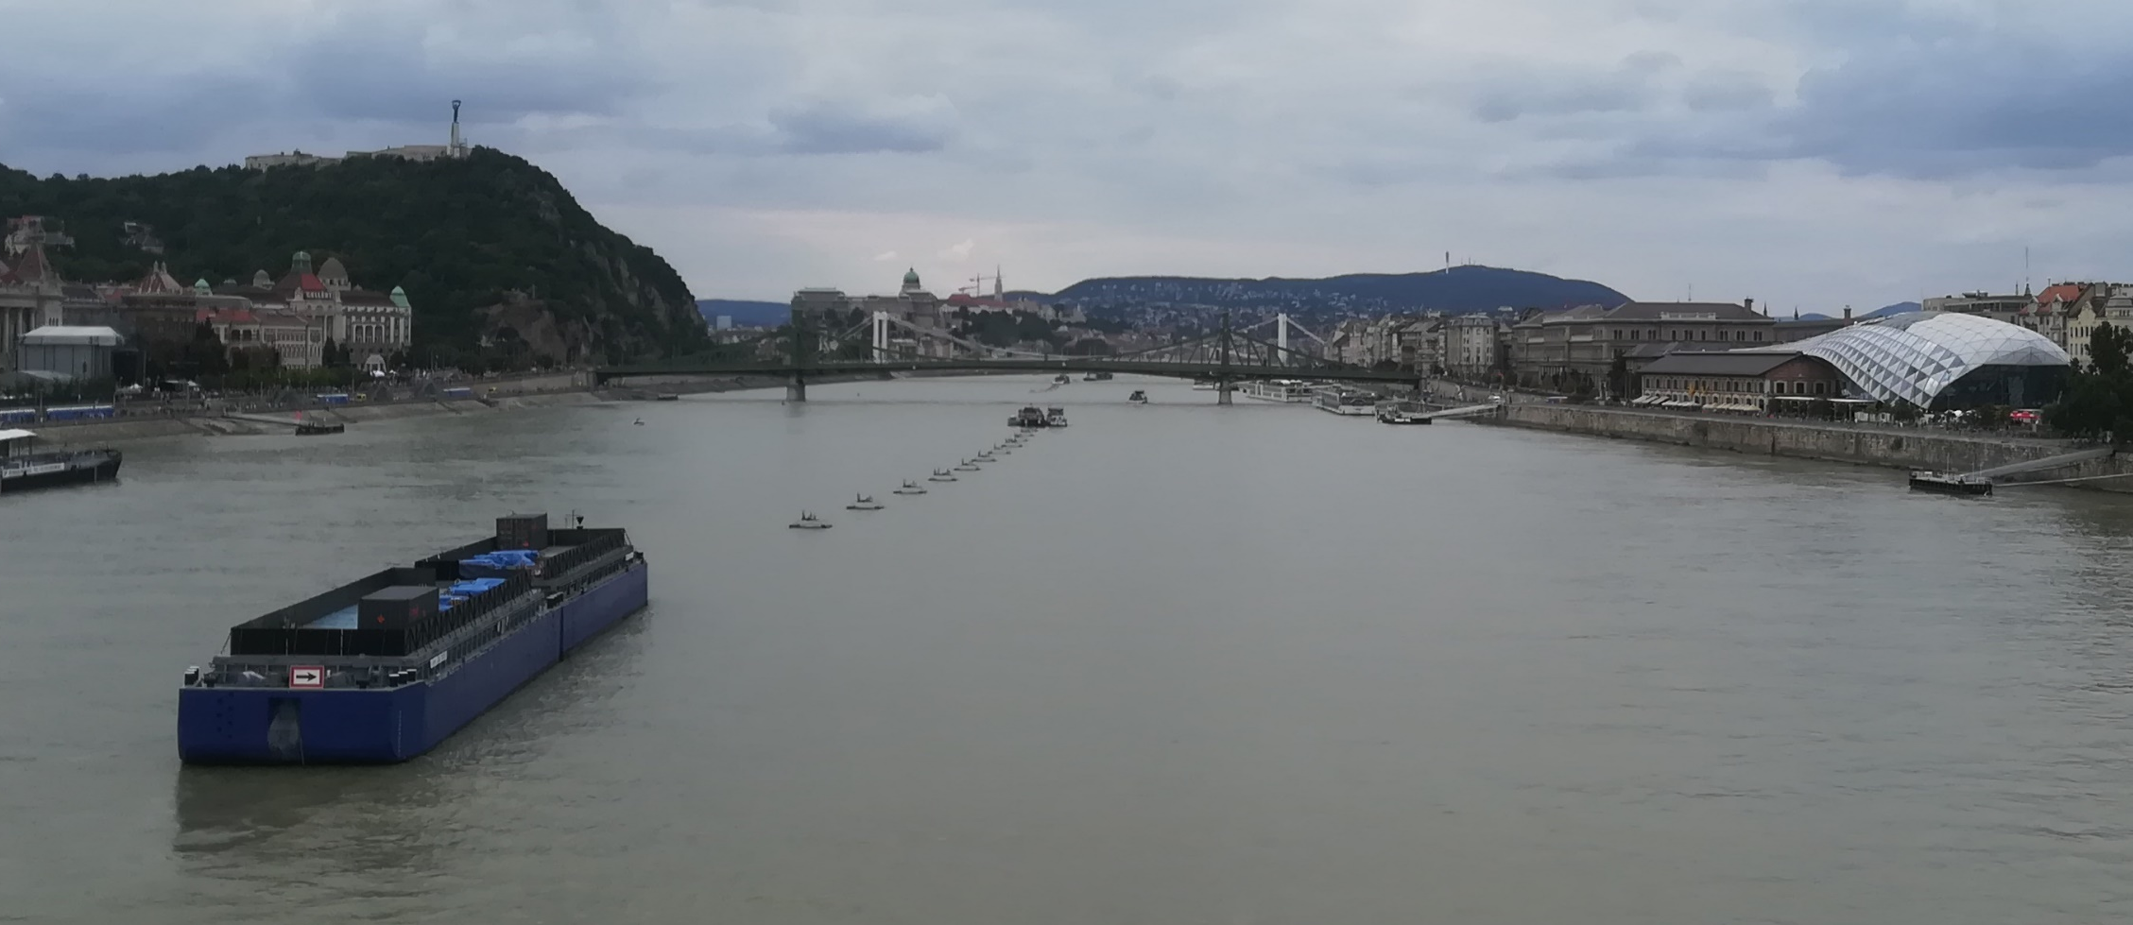
Charges over Danube 2021

Slide 21
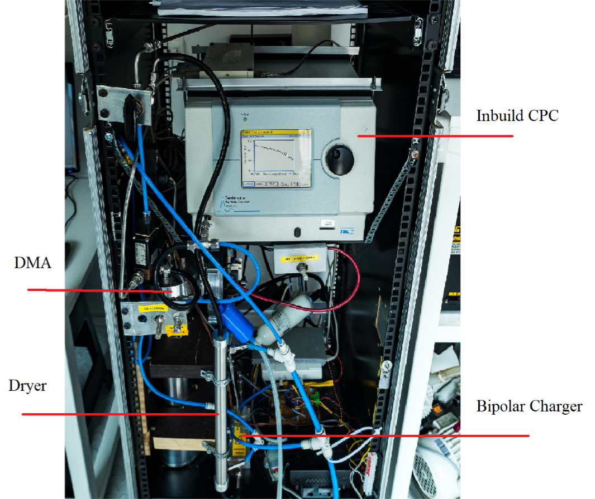
DMPS

Slide 22
Descriptive Statistics
 | Parameter | 2009 | 2014 | 2015 | 2016 | 2017 | 2020 | 2021
BT | N_{6–100} | 16 | 8.0 | 9.2 | 6.5 | 6.5 | 6.1 | 24
 | N_{100–1000} | 3.5 | 2.1 | 1.7 | 2.1 | 0.7 | 1.4 | 5.2
 | WS | 2.0 | 0.7 | 3.6 | 1.4 | 5.2 | 0.8 | 0.5
 | WD | 130 | 32 | 44 | 166 | 15 | 102 | 120
 | T | 24 | 19 | 19 | 26 | 21 | 25 | 24
 | RH | 40 | 73 | 61 | 61 | 49 | 52 | 55
DT | N_{6–100} | 22 | 11 | 8.8 | 12 | 4.3 | 7.2 | 22
 | N_{100–1000} | 7.6 | 3.8 | 2.1 | 8.2 | 0.5 | 1.7 | 57
 | WS | 10 | 0.7 | 4.4 | 1.1 | 4.4 | 1.2 | 1.4
 | WD | 180 | 30 | 45 | 159 | 9 | 101 | 116
 | T | 22 | 19 | 19 | 25 | 19 | 24 | 22
 | RH | 46 | 77 | 64 | 65 | 48 | 58 | 62
AT | N_{6–100} | 26 | 14 | 6.6 | 17 | 6.2 | 7.1 | 18
 | N_{100–1000} | 82 | 4.6 | 1.8 | 3.5 | 0.7 | 1.9 | 4.6
 | WS | 2 | 0.9 | 3.9 | 0.9 | 3.7 | 0.9 | 0.8
 | WD | 110 | 28 | 44 | 28 | 37 | 143 | 122
 | T | 20 | 18 | 18 | 24 | 18 | 23 | 22
 | RH | 58 | 83 | 67 | 70 | 53 | 64 | 63

Slide 23
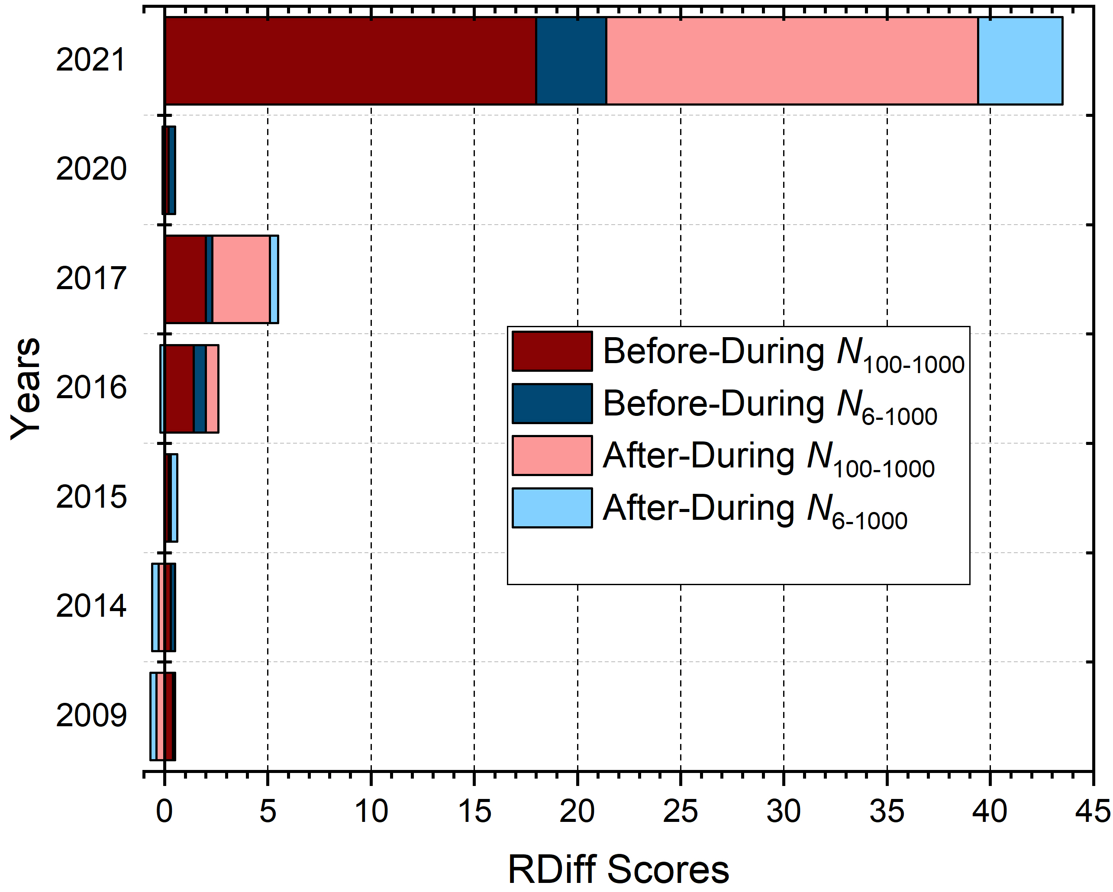
RDiff

Slide 24
CPC Welch’s t-test – Total Particles
Time Frequency | Years | Two-Sided BD | Two-Sided AD | One-Sided BD | One-Sided AD
1s | 2020 | 0.0 | 1.3 × 10⁻⁰⁸ | 0.0 | 6.4 × 10⁻⁰⁹
 | 2021 | 0.0 | 0.0 | 0.0 | 0.0
30s | 2020 | 1.7 × 10⁻¹³ | 0.26 | 8.4 × 10⁻¹⁴ | 0.13
 | 2021 | 5.1 × 10⁻¹⁷ | 2.3 × 10⁻¹⁸ | 2.6 × 10⁻¹⁷ | 1.1 × 10⁻¹⁸
1min | 2020 | 2.3 × 10⁻⁰⁸ | 0.38 | 1.1 × 10⁻⁰⁸ | 0.19
 | 2021 | 4.1 × 10⁻⁰⁹ | 9.2 × 10⁻¹⁰ | 2.0 × 10⁻⁰⁹ | 4.6 × 10⁻¹⁰

